Slide 1
GradeYourCode
FYP II Presentation

Slide 2
Group Members
Shoaib Ahmed (k11-2016)
Zohaib Masood (k112114)
Fawad Jawaid (k11-2116)
Muhammad Zohair (k11-2181)

Slide 3

Problem Statement
It is really difficult for the teachers of an institution to check quizzes of a number of students, check plagiarism among the quizzes and grade them manually.

Slide 4
What is GradeYourCode?
GradeYourCode provides a platform to the teachers to conduct online programming quizzes.
It consists of a web portal which contains an online compiler of C, C++ and Java and a plagiarism detection engine.

Slide 5
Moreover, it has an automatic grading system which assists the teachers to grade the programming quizzes.
Grading is based on the number of quizzes satisfied by the code submitted by the student and the plagiarism percentage determined by the plagiarism detection engine.

Slide 6
Motivation
Our aim is to provide a web portal which facilitates the instructors teaching programming courses with the facility of checking the quizzes. This system would be very useful for catching plagiarism cases and hence restricting the students from copying each other’s code.

Slide 7
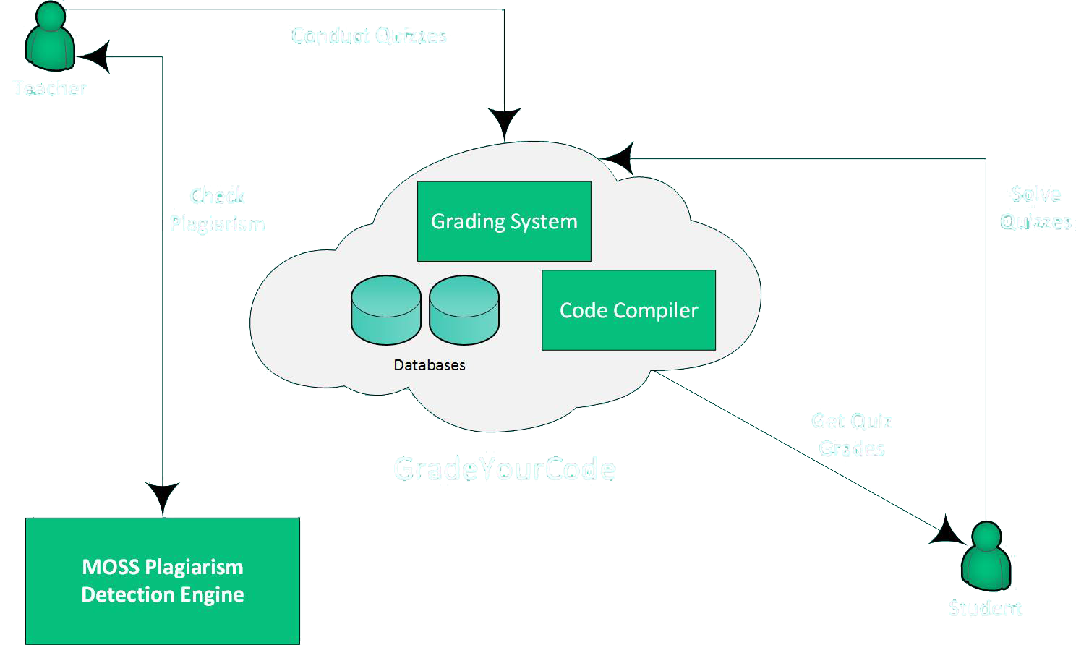
Architecture

Slide 8
Features of GradeYourCode
For Teachers:
Create/ edit question
Add questions to a quiz
Add questions shared by other teachers
Create quiz
Add test cases
Edit deadline of a quiz
View Submissions
View plagiarism percentage

Slide 9
For Students:
Attempt quiz posted by the teacher
Write/Compile code
View output of the code
Submit code
View score obtained in a question/quiz

